Slide 1
Bridging the gap
A digital remittance dApp

Slide 2
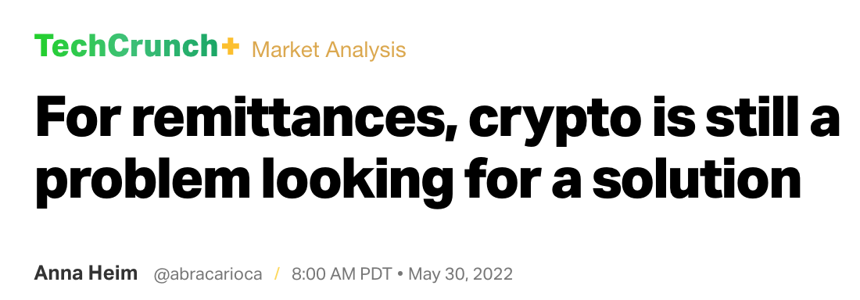

Slide 3


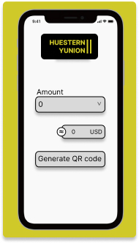

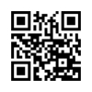


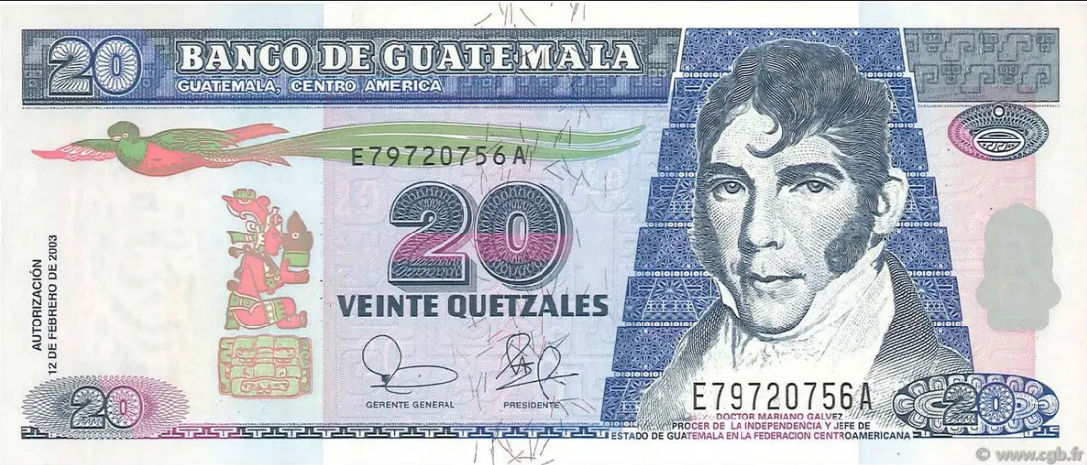
Sender
Beneficiary
http://www.cgb.fr/20-quetzales-guatemala-2003-p-108-pr-neuf,b74_0393,a.html

Slide 4


Slide 5
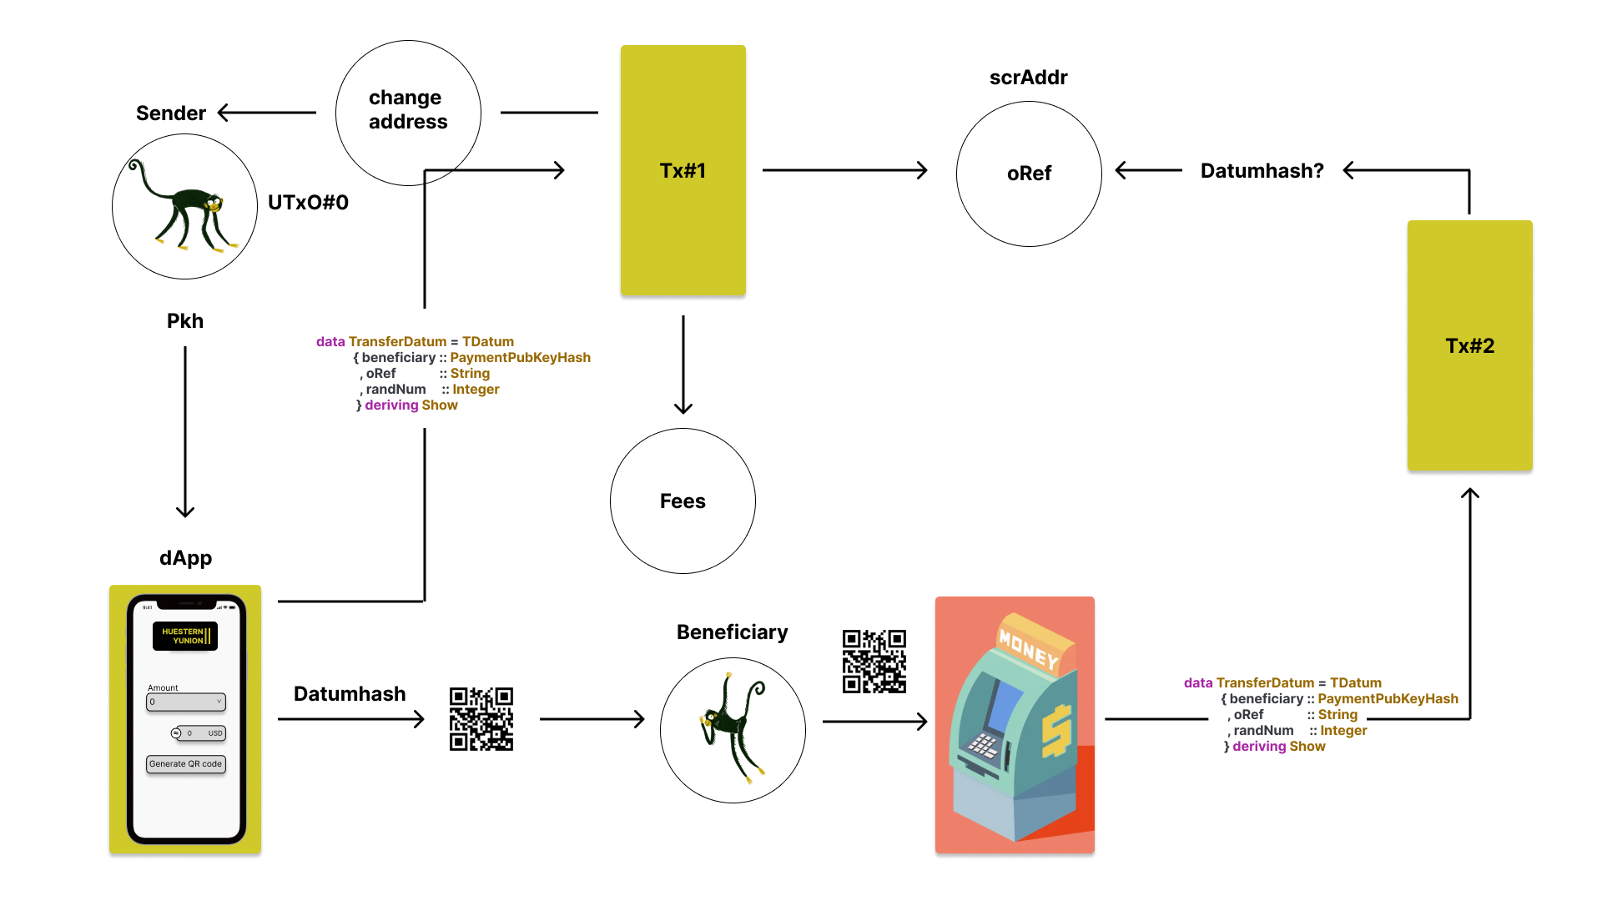

Slide 6
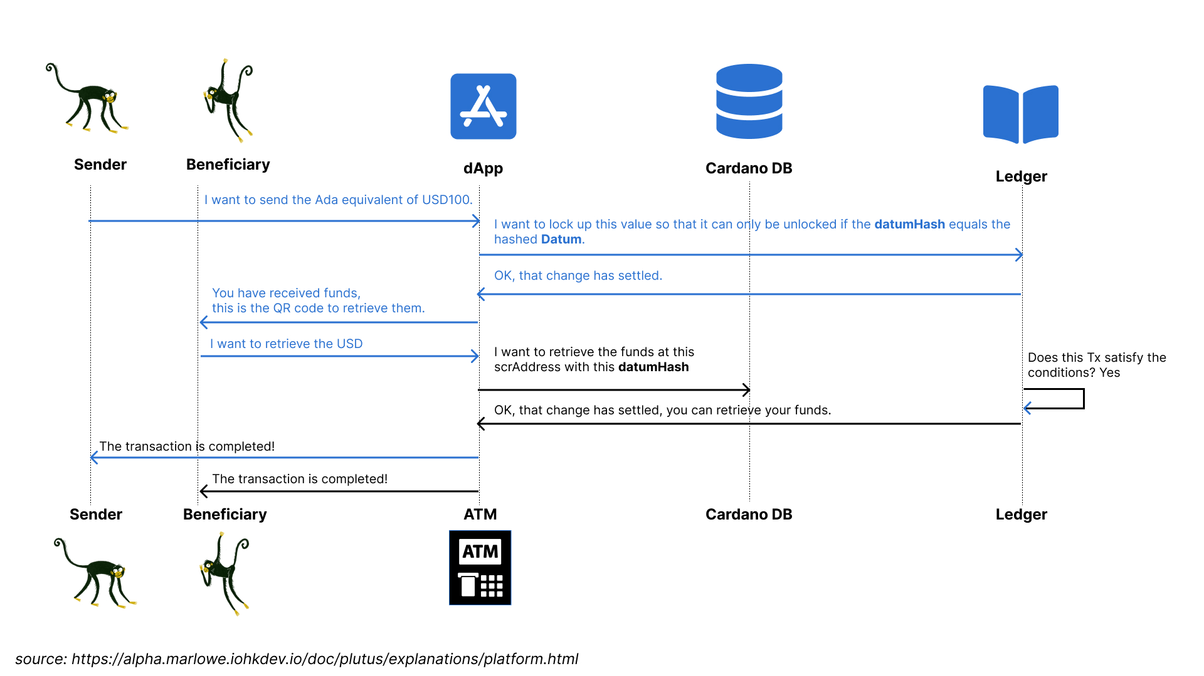

Slide 7
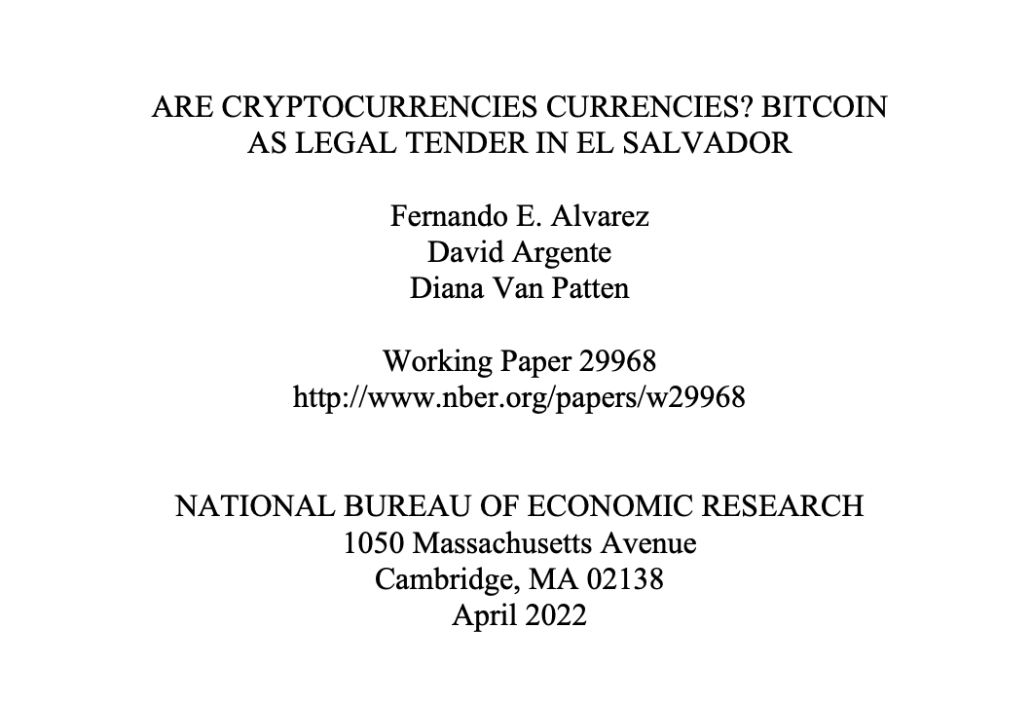
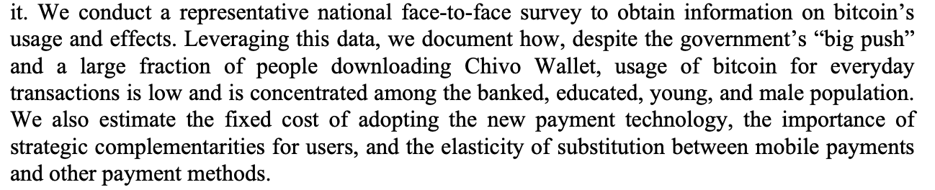
Challenges to adoption

Slide 8
Key objectives
Avoid exposing the beneficiary to technological complexity.
Provide the beneficiary with the value sent in their local currency (not worked out).

